Slide 1
DAYANANDA SAGAR UNIVERSITY
SCHOOL OF ENGINEERING
Department of CSE
(ARTIFICIAL INTELLIGENCE AND MACHINE LEARNING)
ORGANISED ROBOTIC CAR (ORC)
Under the Supervision
Prof. PRADEEP KUMAR K
Presented By:
AGASTHYA R KUMAR (ENG22AM0001)
C VISHNU VARDHAN (ENG22AM0007)
DEEKSHITHA M (ENG22AM0010)
GAYATRI GOVINDA SETTY (ENG22AM0017)

Slide 2
Overview
Abstract
Problem Statement
Introduction
Social/Environmental Impact
State of the Art work(Literature Review)
Design
Partial Implementation
References

Slide 3
Abstract
The next-generation toy car.
Bluetooth control, obstacle detection.
Line following capability using IR sensors.
Applications like motion detection and gas sensing.(plans)
It is also a reliable security companion.
Detect potentially hazardous gas levels, sends the notification for the owner.
Using ARDUINO UNO, IR & gas sensors , piezo buzzer(approach)
Endless possibilities for play, exploration, and peace of mind.
By integrating these tools effectively, you can create a seamless user experience with remote control capabilities and proactive notification alerts, enhancing the functionality and usability of the ORC while ensuring safety and convenience for the owner.

Slide 4
Problem Statement
Problem: "Despite the widespread popularity of toy cars, traditional models lack the ability to adapt to dynamic environments, respond to potential hazards, and provide users with meaningful feedback and control mechanisms. This presents a significant challenge for ensuring the safety, enjoyment, and utility of ORC in various contexts, including playtime at home, educational settings, and outdoor exploration."
Solution: "By developing an ORC equipped with advanced sensing capabilities, intelligent control mechanisms, and proactive notification systems. By integrating technologies such as Arduino microcontrollers, Bluetooth communication, motion sensors, gas detectors, and cloud-based notification services, the ORC can offer enhanced safety, control, and interactivity for users."

Slide 5
Introduction
the project's status in India would depend on various factors, The pace of technological advancement, educational initiatives, government support for innovation and entrepreneurship, and the evolving interests and preferences of makers and enthusiasts.
The scope of the project encompasses the design, development, and implementation of an Arduino-based ORC with various features aimed at providing an engaging and educational experience for children.
Assumption: Availability of Components, Compatibility and Reliability of Components, Programming Skills, Access to Mobile Devices, Wi-Fi Network Availability, Safety Considerations, User Understanding of Notifications, Compliance with Regulations.

Slide 6
Introduction
Plan to do: Project Definition and Objectives,
Resource Identification,
Team Formation,
Project Planning,
Software Development,
Hardware Assembly,
Feature Implementation,
Testing and Debugging,
Documentation,
Deployment and Evaluation.

Slide 7
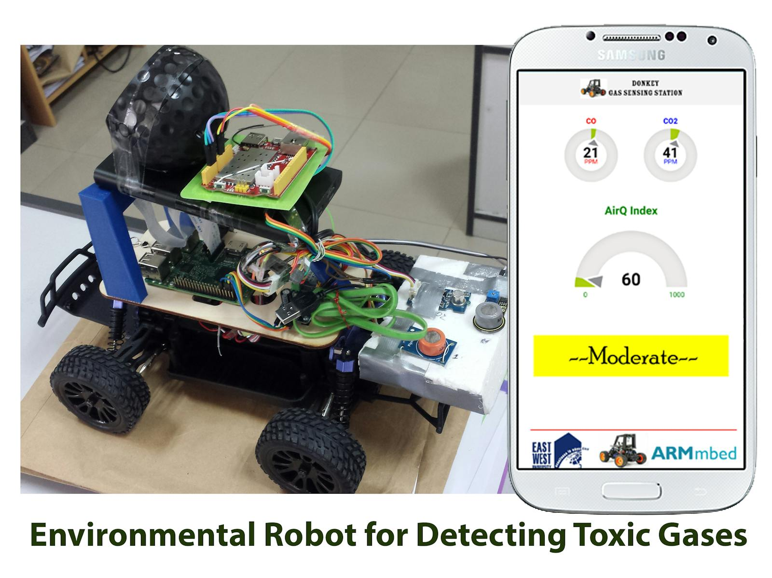
Social/Environmental Impact
the social and environmental impacts of the Arduino-based ORC project extend beyond the realm of technology, encompassing education, creativity, inclusivity, sustainability, Promotion of Sustainable Practices, Skill Development, Parent-Child Bonding, and environmental awareness.
By addressing these aspects holistically, the project has the potential to make a positive difference in the lives of children and communities

Slide 8
State of the Art-work
Paper Title and Author Name | Conference /Journal Name and year | Technology used | What you infer
Design of Intelligent Car Based on Arduino Development Board | 2015 3rd International Conference on Machinery, Materials and Information Technology Applications, 220-223, 2015 | Arduino | Arduino board and how its’s used
Comparative analysis of arduino microcontroller in robotic car by C Rajan, B Meghala, A Nandhini, C Rasi Priya | International journal of mechanical, aerospace, industrial and mecahtronics engineering | DTMF Dual Tone Multiple Frequency, Mobile application, Arduino | Mobile application, Arduino,different types of sensors
Remote and autonomous controlled robotic car based on arduino with real time obstacle detection and avoidance by Esra Yılmaz, Sibel Tarıyan Özyer | Universal Journal of Engineering Science, Vol. 7, No. 1, pp. 1-7. | Bluetooth module, PIR sensor, ultrasonic sensor, and buzzers | Bluetooth module, IR sensor and buzzers
Dept of CSE(AI&ML)., SOE-Dayananda Sagar University

Slide 9
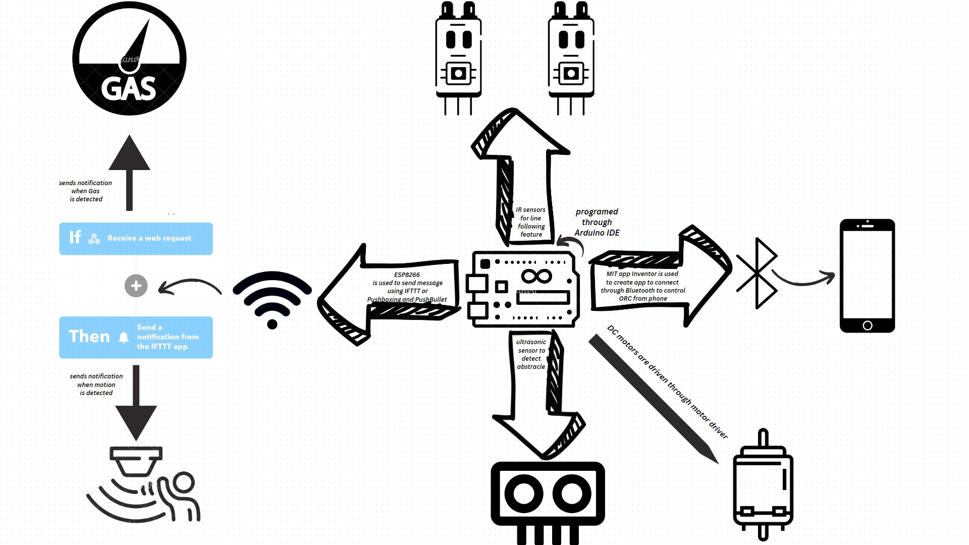
Design

Slide 10
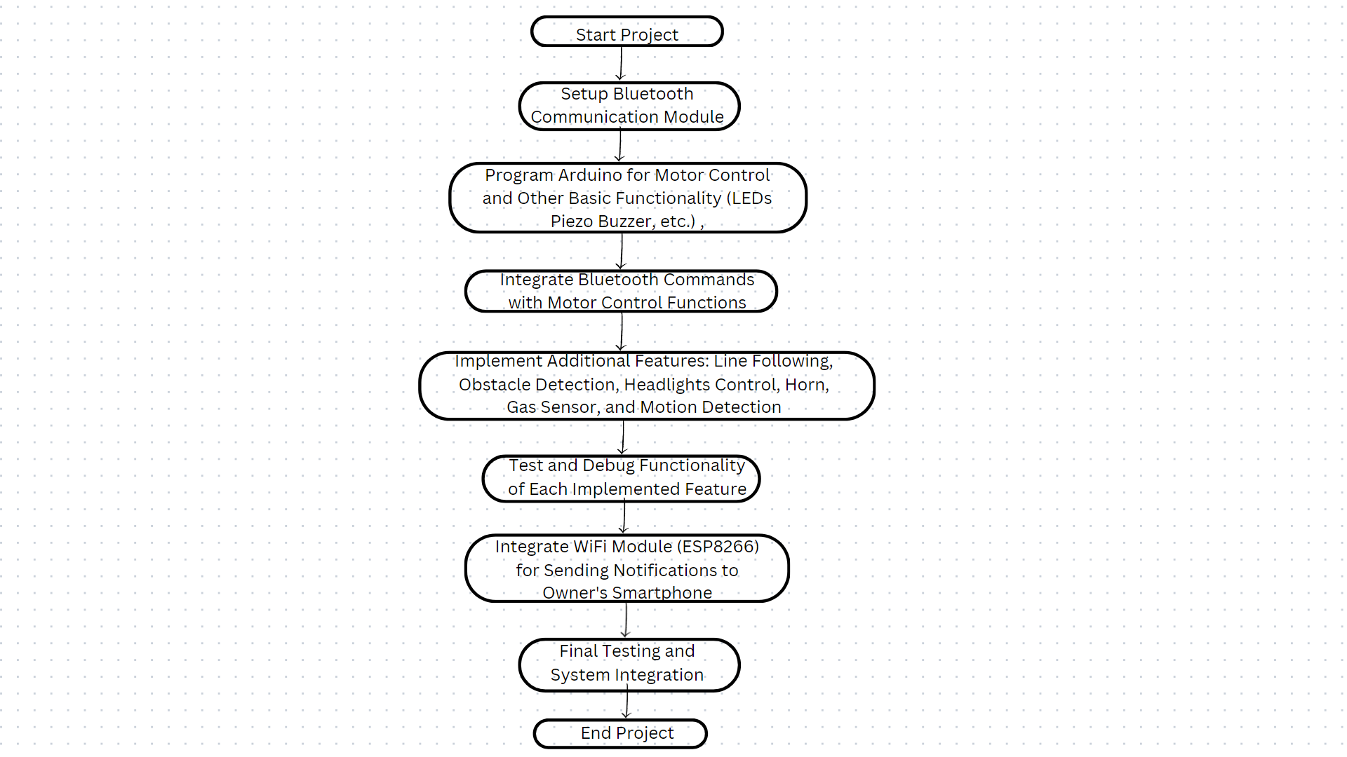
Working of the flow Diagram

Slide 11
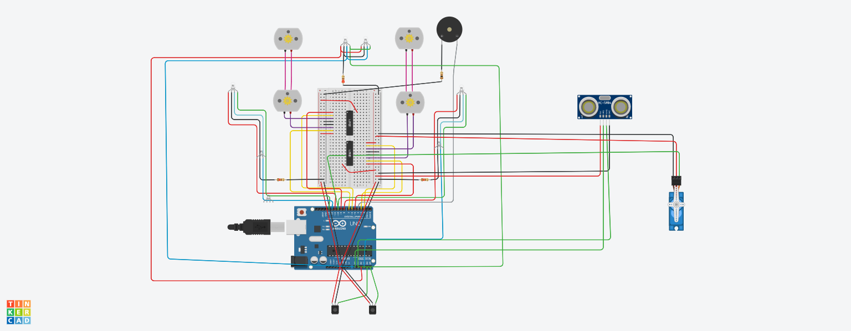
Implementation/Demonstration

Slide 12
References
[1] C. Hanieh , A. Amaya , G. Rafik and K. Frank,” Feature extraction for the differentiation of dry and wet cough sounds”, 2011 IEEE International Symposium on Medical Measurements and Applications, doi: 10.1109/MeMeA.2011.5966670.
[2] S. Matos, S.S. Birring, I.D. Pavord and H. Evans, Detection of cough signals in continuous audio recordings using hidden Markov models, 2006 IEEE Transactions on Biomedical Engineering, doi: 10.1109/TBME.2006.873548, vol. 53, pp. 1078 to 1083.
https://www.arduino.cc
[5] K. Keegan, A.R. Udantha, S. Vinayak and T. Rina, Wavelet Augmented Cough Analysis for Rapid Childhood Pneumonia Diagnosis, 2014 IEEE Transactions on Biomedical Engineering, doi: 10.1109/TBME.2014.2381214, vol. 62, pp. 1185 to 1194.

